Slide 1
Who Are We? Why Are We Here?
Dr. Hiller A. Spires
Distinguished Graduate Professor
North Carolina State University
May 28, 2018

Slide 3
United Nations
Notes:
17 SDG’s action based

Slide 4
Refugees
Reference: http://www.unhcr.org/en-us/figures-at-a-glance.html

Slide 5
Common Read
PBI Global Student Summit Theme:
A World on the Move: Migrants and Refugees

Slide 6
Why is it important to collaborate globally to find solutions to enduring challenges of our times?
Turn and Talk

Slide 7
Long Walk to Water
Notes:
https://www.youtube.com/watch?v=yThjYHz3rhM

Slide 8
Turn and Talk
What did you learn about global water issues from watching the video?

Slide 9
(Thank You!)

Slide 10
Monday Agenda
9:15 – 9:45
Beginning with the End in Mind
Team building Activity
9:45 – 10:00
Review Claims & Evidences
10:00 – 11:00
PSA video creation (Video Length 1-2 minutes)
11:00 – 12:00
External Expert Review
Edit and Revise PSA - Based on Feedback
12:00 – 1:00 Lunch in Cafe

Slide 11
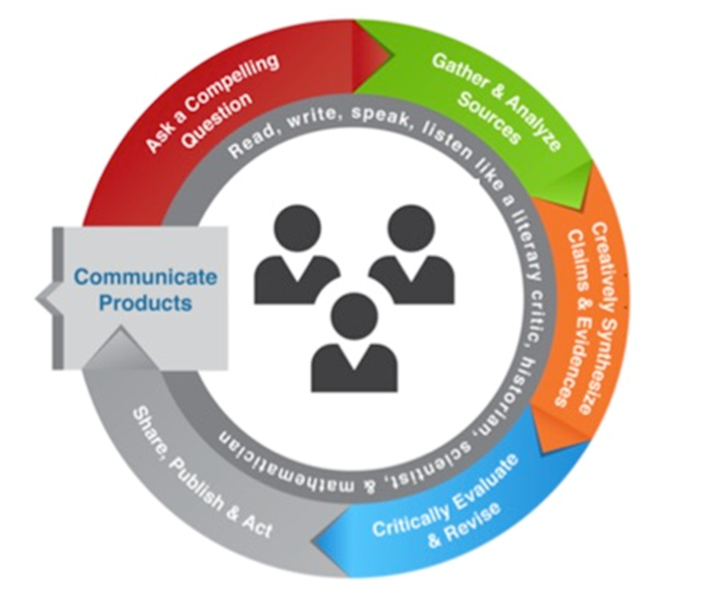
Beginning With The End In Mind
PBI Global Student Summit Showcase on Wednesday
10 Minute Team Presentations
30 Minute Gallery Walk
Remember to:
Do your best work
Be respectful as you collaborate
Listen and act as a team

Slide 12
Cultural Analogies
6 Images
Two Minutes
Discussion Questions:
What is the similarity between the object in front of you and culture?
What insight does this give you about how to work effectively across cultures?
Debrief
Each group presents a summary of their discussion
Who are you?
What is your image?
What did your group say in response to the 2 discussion questions?
Whole Group Discussion
What is the connection between these cultural analogies and our goals for the 2018 PBI Global Student Summit?

Slide 13
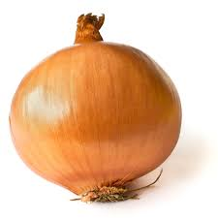
Onion
Notes:
Like an onion, people are shaped by many layers of culture: national culture, regional culture, organizational culture, and many other types of culture (gender, religion, family, etc.).
Often, we may catch ourselves thinking about someone as only one layer, for example, a French person or a woman. We then typically get stuck in divisive language: us and them. When we think of or see only one layer of an individual, we are not seeing that person for the complex individual he or she is and what he or she brings to a situation. We want to be recognized as being complex individuals shaped by a number of layers, and we need to do the same for others.

Slide 14
Iceberg
Notes:
When we think of a culture, we often tend to think of the tip of the iceberg elements (food, dress, national symbols such as famous buildings, a nation’s flag, etc.), yet the majority of culture is hidden from view and is represented by deeper elements of culture, such as ideas about what is right and wrong and fundamental beliefs.
The deeper the element of a culture’s iceberg you experience, the harder it is to adapt or shift. We can often adapt more easily to the local customs of dress or food, or adopt another culture's way of doing, such as how to pass out business cards, but when asked to switch how we think about something, or when our worldview is different from someone else’s, it becomes more challenging.
The goal of learning about cultures is to continue to probe the depths of an iceberg to seek to understand the drivers behind the actions and behaviors of another.

Slide 15
Fish In Water
Notes:
Like water to a fish, the influence of our own culture is often invisible to us; it is simply what we know and what we depend on for survival.
It is not until we become a fish out of water that we may realize our dependency on our own cultural environments or be able to see clearly what the water was that we lived in.
Often the first step in working across cultures is to discover your own ocean and understand your own cultural influences.

Slide 16
Lenses
Notes:
Refer to the quote attributed to French-Cuban writer Anais Nin: “We don’t see things as they are; we see them as we are.” Not that culture is a system for making meaning of things, and as a result, we all wear cultural lenses or filters when we interpret a situation. This may lead to different concepts about everything, from what makes a good meeting to the role of a teacher or leader.
Highlight that the goal of working across cultures is to recognize our own lenses or cultural filter we are wearing in any situation and learn to put on the lenses of someone from a different cultural background.

Slide 17
House
Notes:
Culture, like a house, is a refuge and a place of comfort. When interacting across cultures, it is important people understand there will be some discomfort in moving beyond the house.
Clear boundaries delineate the inside of the house from the rest of the world. Likewise, culture often determines who is part of our group (the IN group) and who is not part of our group and not like us (the OUT group). This is one of the realities of the human experience. In crossing cultures, it is important to pay attention to how we respond to those who are not like us.

Slide 18
Tree
Notes:
Culture, like a tree, has deep roots and it is important to understand historical contexts of cultures.
Likewise, there are different variations (branches of the tree) in a culture but they come from the same roots. Thus, when we talk about a culture, it’s important to remember it is not monolithic and static but is changing, growing, and contains many variations.

Slide 19
Toolkit For Working Across Cultures
Ex. Onion – People are complex; respect and seek to peel the layers of the onion.

Slide 20
Tuesday Agenda
8:30 – 8:45
Welcome
8:45 – 11:00
Finalize PSA
Feedback from External Experts
Write Script for Presentation (Total Length 7 – 10 minutes, including video)
11:00 – 12:30
Dress Rehearsal
Round 1: In teams, receive presentation feedback from external experts & coaches
Round 2: Whole group presentation
12:30 – 1:30 Lunch

Slide 21
Wednesday Agenda
8:30 – 8:45
Welcome
8:45 – 10:00
Setup Gallery Exhibition tables
Infographic, computer, PSA, & claim sheet
Practice presentations
10:00 – 12:00 Showcase
12:00 – 12:30 Gallery Exhibition
12:30 – 1:30 Lunch

Slide 22
High Level Meeting
May 2018

Slide 23
State of the School
Mr. Bintai Wang
Dr. Lisa Wang
Dr. Alison Schleede

Slide 24
Taking SNA from Good to Great
Dr. Hiller A. Spires
Distinguished Graduate Professor
North Carolina State University
May 2018

Slide 26
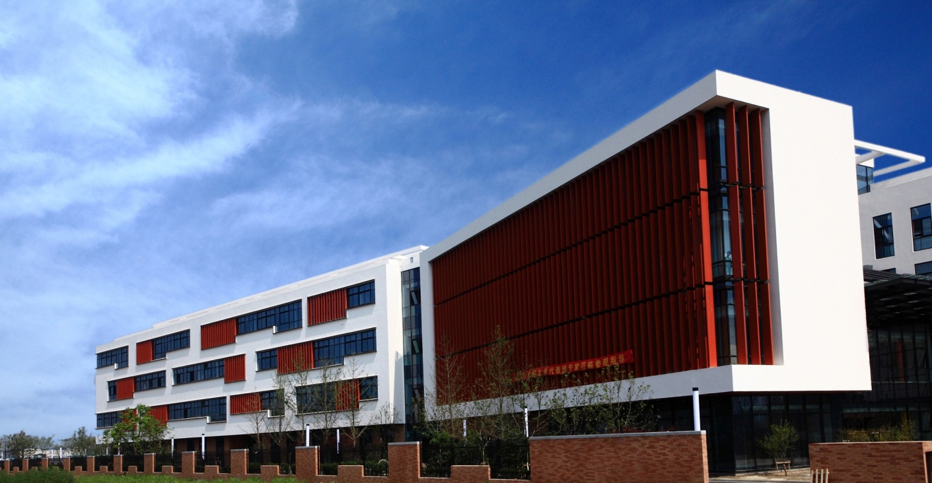
SNA: From Good to Great
Greatness is not a function of circumstance. Greatness, it turns out, is largely a matter of conscious choice, and discipline.
- Jim Collins
Adapted from JIM’S GOOD TO GREAT OVERVIEW POWERPOINT DEVELOPED BY JIM COLLINS. © 2014 BY JIM COLLINS. ALL RIGHTS RESERVED.
Notes:
Add building to slide.

Slide 27
Overview of Key Concepts
Good to Great and the Social Sectors
by
Jim Collins
Notes:
“it’s not circumstance…”back of the book quote
SNA Logo
SNA: From Good to Great

Slide 28
The “Good to Great” Formula
Four Key Stages
Cultivate top talent
Engage in intentional thought
Take intentional action
Make “greatness” endure over time
Notes:
Hiring the right people b/c we can’t control the students coming into the school so we need to get the right people
PLC part/Staff development & Vision Making (How do you fit into the school’s vision); how do we define success
Carrying out the vision/ Organizational chart

Slide 29
Stage 1: Cultivate top talent
Select effective people who demonstrate personal humility and professional will
Get the right people “on the bus.”
Do not allow people to stay “on the bus” if they do not have the right traits.

Slide 30
Stage 2: Engage in intentional thought
Face the brutal facts about your organization
Have the faith to believe you will survive and thrive
Answer three pivotal questions:
What is SNA deeply passionate about?
What can SNA be the best in the world at?
What best drives SNA’s economic or resource engine?

Slide 31
Stage 3:Take intentional action
Stick to the Hedgehog Elements
Passion
Best At
Resource Engine
Power and success builds slowly at first and then increasing momentum over time

Slide 32
Stage 4: Build greatness to last
Longevity of great organizations is related to clear and consistent organizational structures.
Long-lasting organizations implement strategies to stimulate organizational progress.
Lasting organizations are based on consistent core values yet relentlessly assess themselves to adapt to an ever-changing world.

Slide 33
Work Session
Revisit the action items from the SNA Good to Great Memo (August 2017).
Analyze your progress to date.

Slide 34
SNA Parent Perceptions on International Higher Education Research presented at the AERA conference 2018 in NYC

Slide 35
International Academic Mobility (IAM)
Many parents seek international higher education opportunities for their students, with most students going to university in the US, Canada, and Australia (Fang & Wang, 2014; Schultz, 2015).
Number of Chinese students attending international higher ed has increased by 20% annually since 2008 (Cao, et al., 2016).

Slide 36
Research Question
What are SNA parents’ perspectives on their children attending college in the United States?
Notes:
Interviewed 8 parents in 2 sets of focus groups and administered a survey in 2016.

Slide 37
Findings—Theme One
SNA parents value broad, global opportunities for their children
Future job opportunities
Offers global vision

Slide 38
Findings—Theme Two
Advanced technology and innovation are keys to the future
Think US is a very advanced country that offers opportunities for learning
High tech is attractive

Slide 39
Findings—Theme Three
SNA parents seek rigorous and resource-rich educational experiences
More rigorous than Chinese colleges
Critical thinking and openness are important
Vague ideas about resources

Slide 40
Findings—Theme Four
Concerns about safety, security, and cost exist
Cost for international higher ed is much higher in US
Gun violence in the US mentioned

Slide 41
Now It’s Your Turn
How have SNA parent perceptions on international higher education evolved in the last 2 years?

Slide 42
Recruitment
Marie Himes
May 2018

Slide 43
SNA Teacher Recruitment 2017-2018
Career Fairs & Candidates
Appalachian State University
Patrick Campbell, Physics
Ashlyn Creamer, Chemistry & Biology
Hunter Hill, Art,
Vincent Mazzo, English
University of Virginia
Lauren Tabor, Biology
Edward Walters, Social Studies
James Madison University
Christian Morreale, English
North Carolina State University
Kaiya Brown, English
Jonathan Adams, English
Charles Iseminger, Social Studies (UNC – CH)
Scarlet Jovin, Art (Exploris School)
Wenli Liu, Mandarin & English
University Career Websites (Over 200 Postings)
Eastern Michigan University
Miri Lee, English
NC State College of Education Course Visits (Fall and Spring)
English Undergraduate Methods & Master in Teaching
Science Undergraduate Methods & Master in Teaching
Social Studies Master in Teaching
Math Undergraduate Methods & Master in Teaching
Notes:
Share this info + monthly meetings with Roven and Anne to discuss personnel needs

Slide 44
Teachers Working Conditions Survey
Dr. Hiller A. Spires
Distinguished Graduate Professor
North Carolina State University
May 2018

Slide 45
Results from the NC Teachers Working Conditions Survey
NC Teachers Working Conditions Survey
Conducted annually for all teachers in North Carolina
Surveyed more than 1.5M teachers across 18 states
Validity and reliability established over 9 years
Adapted and administered for SNA Teachers June 2017
All responses are anonymous and confidential

Slide 46
Teacher Survey Participation
Out of 67 teachers, 43 completed the survey.

Slide 47
Use of Time
Years of Data:
2017 (Black)
2018 (Red)
 | Strongly Disagree | Disagree | Agree | Strongly Agree
Teachers have time available to collaborate with colleagues. | 3 (12.0%) | 7 (28.0%) | 11 (44.0%) | 4 (16.0%)
 | 3 (6.4%) | 8 (17%) | 26 (55.3%) | 9 (19.1%)
Efforts are made to minimize the amount of routine paperwork teachers are required to do. | 6 (25.0%) | 2 (8.3%) | 10 (41.7%) | 6 (25.0%)
 | 3 (6.4%) | 10 (21.3%) | 27 (57.4%) | 6 (12.8%)
The non-instructional time provided for teachers in my school is sufficient. | 6 (26.1%) | 8 (34.8%) | 5 (21.7%) | 4 (17.4%)
 | 4 (8.3%) | 13 (27.1%) | 26 (54.2%) | 5 (10.4%)
Teachers are protected from duties that interfere with their essential role of educating students. | 11 (45.8%) | 6 (25.0%) | 5 (20.8%) | 2 (8.3%)
 | 10 (20.8%) | 12 (25.0%) | 18 (37.5%) | 7 (14.6%)

Slide 48
Facilities and Resources
Years of Data:
2017 (Black)
2018 (Red)
 | Strongly Disagree | Disagree | Agree | Strongly Agree
Teachers have sufficient access to instructional technology, including computers, devices, printers, software and internet access. | 2 (9.1%) | 4 (18.2%) | 12 (54.5%) | 4 (18.2%)
 | 8 (17.8%) | 8 (17.8%) | 19 (42.2%) | 10 (22.2%)
The school environment is clean and well maintained. | 0 (0.0%) | 2 (9.1%) | 15 (68.2%) | 5 (22.7%)
 | 1 (2.2%) | 5 (11.1%) | 21 (46.7%) | 17 (37.8%)
The physical environment of classrooms in this school supports teaching and learning. | 3 (13.6%) | 3 (13.6%) | 14 (63.6%) | 2 (9.1%)
 | 4 (8.9%) | 7 (15.6%) | 22 (48.9%) | 12 (26.7%)

Slide 49
Managing Student Conduct
Years of Data:
2017 (Black)
2018 (Red)
 | Strongly Disagree | Disagree | Agree | Strongly Agree | Don’t Know
Students at this school understand expectations for their conduct. | 4 (21.1%) | 8 (42.1%) | 5 (26.3%) | 2 (10.5%) | 0 (0.0%)
 | 7 (15.6%) | 9 (20.0%) | 26 (57.8%) | 3 (6.7%) | 0 (0.0%)
Policies and procedures about student conduct are clearly understood by the faculty. | 4 (21.1%) | 6 (31.6%) | 7 (36.8%) | 0 (0.0%) | 2 (10.5%)
 | 3 (6.7%) | 8 (17.8%) | 25 (55.6%) | 8 (17.8%) | 1 (2.2%)
The faculty work in a school environment that is safe. | 2 (10.0%) | 1 (5.0%) | 12 (60.0%) | 5 (25.0%) | 0 (0.0%)
 | 1 (2.2%) | 4 (8.9%) | 23 (51.1%) | 17 (37.8%) | 0 (0%)

Slide 50
Teacher Leadership
Years of Data:
2017 (Black)
2018 (Red)
 | Strongly Disagree | Disagree | Agree | Strongly Agree | Don’t Know
Teachers are recognized as educational experts. | 4 (21.1%) | 7 (36.8%) | 5 (26.3%) | 2 (10.5%) | 1 (5.3%)
 | 5 (11.1%) | 7 (15.6%) | 26 (57.8%) | 7 (15.6%) | 0 (0%)
Teachers are trusted to make sound professional decisions about instruction. | 4 (21.1%) | 3 (15.8%) | 8 (42.1%) | 4 (21.1%) | 0 (0.0%)
 | 4 (8.9%) | 7 (15.6%) | 20 (44.4%) | 13 (28.9%) | 1 (2.2%)
Teachers are encouraged to participate in school leadership roles. | 6 (31.6%) | 5 (26.3%) | 4 (21.1%) | 3 (15.8%) | 1 (5.3%)
 | 6 (13.3%) | 7 (15.6%) | 25 (55.6%) | 6 (13.3%) | 1 (2.2%)
The faculty has an effective process for making group decisions to solve problems. | 7 (36.8%) | 4 (21.1%) | 6 (31.6%) | 1 (5.3%) | 1 (5.3%)
 | 10 (22.2%) | 8 (17.8%) | 21 (46.7%) | 4 (8.9%) | 2 (4.4%)

Slide 51
Teacher Leadership
Years of Data:
2017 (Black)
2018 (Red)
Indicate the role teachers have at your school in each of the following areas.
 | No role at all | Small role | Moderate role | Large role | Don’t know
Devising teaching techniques | 3 (15.8%) | 2 (10.5%) | 3 (15.8%) | 9 (47.4%) | 2 (10.5%)
 | 4 (9.1%) | 3 (6.8%) | 14 (31.8%) | 23 (52.3%) | 0 (0.0%)
Determining the content of in-service professional development programs | 6 (31.6%) | 2 (10.5%) | 5 (26.3%) | 4 (21.1%) | 2 (10.5%)
 | 12 (26.7%) | 4 (8.9%) | 22 (48.9%) | 5 (11.1%) | 2 (4.4%)
The selection of teachers new to this school | 13 (68.4%) | 1 (5.3%) | 3 (15.8%) | 1 (5.3%) | 1 (5.3%)
 | 26 (57.8%) | 4 (8.9%) | 10 (22.2%) | 1 (2.2%) | 4 (8.9%)
School improvement planning | 8 (42.1%) | 6 (31.6%) | 3 (15.8%) | 1 (5.3%) | 1 (5.3%)
 | 24 (54.5%) | 3 (6.8%) | 11 (25.0%) | 4 (9.1%) | 2 (4.5%)

Slide 52
School Leadership
Years of Data:
2017 (Black)
2018 (Red)
 | Strongly Disagree | Disagree | Agree | Strongly Agree | Don’t Know
The faculty and staff have a shared vision. | 5 (27.8%) | 5 (27.8%) | 5 (27.8%) | 1 (5.6%) | 2 (11.1%)
 | 9 (20.0%) | 10 (22.2%) | 22 (48.9%) | 3 (6.7%) | 1 (2.2%)
There is an atmosphere of trust and mutual respect in this school. | 5 (27.8%) | 8 (44.4%) | 4 (22.2%) | 1 (5.6%) | 0 (0.0%)
 | 9 (20.0%) | 8 (17.8%) | 22 (48.9%) | 6 (13.3%) | 0(0.0%)
Teachers feel comfortable raising issues and concerns that are important to them. | 7 (38.9%) | 4 (22.2%) | 3 (16.7%) | 4 (22.2%) | 0 (0.0%)
 | 10 (22.2%) | 10 (22.2%) | 17 (37.8%) | 6 (13.3%) | 2 (2.2%)
The school leadership consistently supports teachers. | 7 (38.9%) | 5 (27.8%) | 4 (22.2%) | 1 (5.6%) | 1 (5.6%)
 | 11 (24.4%) | 5 (11.1%) | 21 (46.7%) | 8 (17.8%) | 0 (0.0%)
Teachers receive feedback that can help them improve teaching. | 5 (27.8%) | 6 (33.3%) | 5 (27.8%) | 1 (5.6%) | 1 (5.6%)
 | 7 (15.6%) | 10 (22.2%) | 19 (42.2%) | 8 (17.8%) | 1 (2.2%)
The faculty are recognized for accomplishments. | 2 (11.1%) | 3 (16.7%) | 11 (61.1%) | 2 (11.1%) | 0 (0.0%)
 | 6 (13.6%) | 6 (13.6%) | 23 (52.3%) | 7 (15.9%) | 2 (4.5%)

Slide 53
School Leadership
Years of Data:
2017 (Black)
2018 (Red)
The school leadership makes a sustained effort to address teacher concerns about:
 | Strongly Disagree | Disagree | Agree | Strongly Agree | Don’t Know
The use of time in my school | 6 (33.3%) | 6 (33.3%) | 4 (22.2%) | 2 (11.1%) | 0 (0.0%)
 | 11 (24.4%) | 7 (15.6%) | 20 (44.4%) | 6 (13.3%) | 1 (2.2%)
Professional development | 5 (27.8%) | 4 (22.2%) | 6 (33.3%) | 2 (11.1%) | 1 (5.6%)
 | 5 (11.1%) | 5 (11.1%) | 25 (55.6%) | 9 (20.0%) | 1 (2.2%)
New teacher support | 6 (33.3%) | 5 (27.8%) | 5 (27.8%) | 2 (11.1%) | 0 (0.0%)
 | 8 (17.8%) | 6 (13.3%) | 16 (35.6%) | 13 (28.9%) | 2 (4.4%)

Slide 54
Professional Development
Years of Data:
2017 (Black)
2018 (Red)
 | Strongly Disagree | Disagree | Agree | Strongly Agree | Don’t Know
An appropriate amount of time is provided for professional development. | 3 (18.8%) | 7 (43.8%) | 4 (25.0%) | 2 (12.5%) | 0 (0.0%)
 | 6 (13.3%) | 11 (24.4%) | 23 (51.1%) | 4 (8.9%) | 1 (2.2%)
Professional development is differentiated to meet the individual needs of teachers. | 6 (37.5%) | 4 (25.0%) | 3 (18.8%) | 1 (6.3%) | 2 (12.5%)
 | 9 (20.0%) | 11 (24.4%) | 21 (46.7%) | 4 (8.9%) | 0 (0.0%)
Professional development enhances teachers’ ability to implement instructional strategies that meet diverse student learning needs. | 3 (18.8%) | 4 (25.0%) | 8 (50.0%) | 1 (6.3%) | 0 (0.0%)
 | 9 (20.0%) | 8 (17.8%) | 22 (48.9%) | 5 (11.1%) | 1 (2.2%)
Professional development enhances teachers’ abilities to improve student learning. | 4 (25.0%) | 2 (12.5%) | 8 (50.0%) | 1 (6.3%) | 1 (6.3%)
 | 7 (15.6%) | 8 (17.8%) | 24 (53.3%) | 6 (13.3%) | 0 (0.0%)

Slide 55
Instructional Practices and Support
Years of Data:
2017 (Black)
2018 (Red)
 | Strongly Disagree | Disagree | Agree | Strongly Agree
The curriculum taught in this school is aligned with Common Core Standards. | 3 (18.8%) | 3 (18.8%) | 9 (56.3%) | 1 (6.3%)
 | 7 (17.5%) | 5 (12.5%) | 24 (60.0%) | 4 (10.0%)
Teachers work in professional learning communities to develop and align instructional practices. | 6 (37.5%) | 4 (25.0%) | 4 (25.0%) | 2 (12.5%)
 | 4 (10.0%) | 7 (17.5%) | 23 (57.5%) | 5 (12.5%)
Provided supports (i.e. instructional coaching, professional learning communities, etc.) translate to improvements in instructional practices by teachers. | 5 (31.3%) | 5 (31.3%) | 5 (31.3%) | 1 (6.3%)
 | 3 (7.5%) | 9 (22.5%) | 21 (52.5%) | 5 (12.5%)
Teachers are encouraged to try new things to improve instruction. | 2 (12.5%) | 2 (12.5%) | 8 (50.0%) | 4 (25.0%)
 | 2 (5.0%) | 3 (7.5%) | 28 (70.0%) | 7 (17.5%)

Slide 56
Instructional Practices and Support
Years of Data:
2017 (Black)
2018 (Red)
 | Strongly Disagree | Disagree | Agree | Strongly Agree | Don’t Know
Teachers have autonomy to make decisions about instructional delivery (i.e. pacing, materials, and pedagogy). | 4 (25.0%) | 1 (6.3%) | 7 (43.8%) | 4 (25.0%) | 0 (0.0%)
 | 2 (5.0%) | 1 (2.5%) | 29 (72.5%) | 8 (20.0%) | 0 (0.0%)
Teachers believe what is taught will make a difference in students’ lives. | 1 (6.3%) | 3 (18.8%) | 10 (62.5%) | 2 (12.5%) | 0 (0.0%)
 | 2 (5.0%) | 7 (17.5%) | 25 (62.5%) | 6 (15.0%) | 0 (0.0%)
Teachers require students to work hard. | 2 (13.3%) | 3 (20.0%) | 8 (53.3%) | 1 (6.7%) | 1 (6.7%)
 | 1 (2.5%) | 5 (12.5%) | 24 (60.0%) | 9 (22.5%) | 1 (2.5%)
Teachers use digital content and resources in their instruction. | 2 (12.5%) | 1 (6.3%) | 12 (75.0%) | 1 (6.3%) | 0 (0.0%)
 | 0 (0.0%) | 4 (10.0%) | 27 (67.5%) | 9 (22.5%) | 0 (0.0%)

Slide 57
Teacher Recommendations
Recommendations for Beginning Teachers:
Mentors
Establish formal meetings with mentor during school hours.
Reduce the workload
Regular communication with administrators
Recommendations for Professional Development:
Differentiating instruction
Methods of teaching

Slide 58
Summary of Results
Areas for Growth:
Protect teachers from duties that interfere with their essential role of educating students.
Develop an effective group decision process for the faculty to solve problems.
Involve faculty and staff in shared vision creation.
Provide opportunities for teachers to comfortably raise issues and concerns that are important to them.
Seek teacher input on school calendar and schedule.

Slide 59
Developing an SNA School Improvement Plan
Now it’s Your Turn

Slide 60
“A heart and mind for wanting to learn.”
好学心 Dr. Jin Li
Image from COSN
Notes:
Show PBI Global ECHS/SNA Subtitle

Slide 61
STUDENT SUMMIT SHOWCASE
MAY 30, 2018

Slide 62
STUDENT SUMMIT SHOWCASE
WELCOME from Mr. Wang Bintai Suzhou North America High School

Slide 64
STUDENT SUMMIT SHOWCASE
Dr. Hiller A. Spires North Carolina State University

Slide 65
Dr. Alison Schleede Suzhou North America High School
Andrea Gambino
Wake STEM Early College High School
Brianna Conroy & Imam (Shantro) Asfi Suzhou North America High School

Slide 66
STUDENT SUMMIT SHOWCASE
MAY 30, 2018

Slide 67
(Thank You!)

